Slide 1


Impact of Water on Dust
(Water Sprays)
Suppression – prevent generation
Capture – remove from air (water or mechanical means)
Redirection – directed away from worker

Slide 2
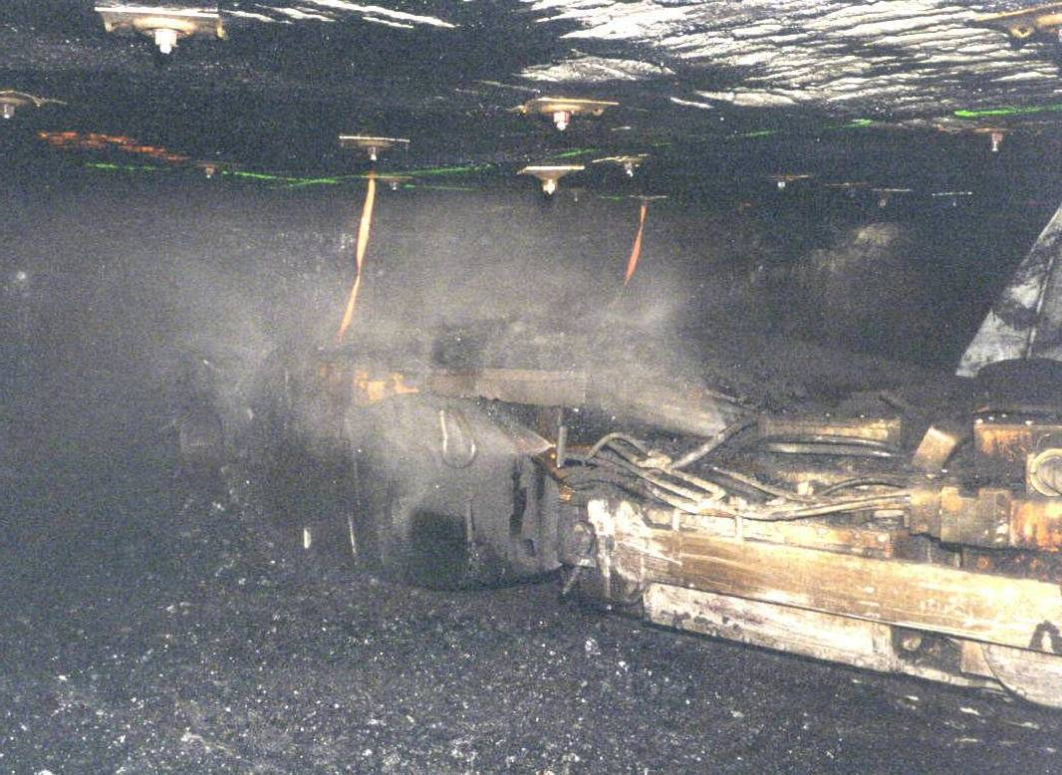
Water Sprays on Continuous Miners
Function:
  Suppress/wet
  Capture
  Redirect
Application:
  High flow/low pressure
  Droplet size/velocity
  High pressure/location

Slide 3
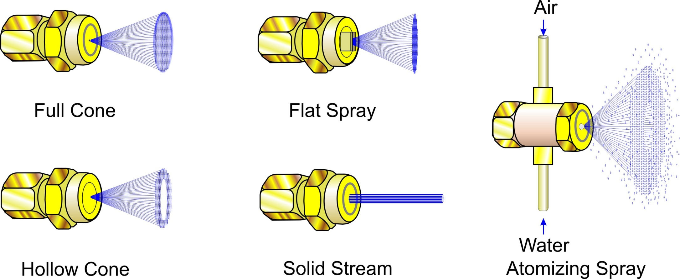
Spray Types

Slide 4
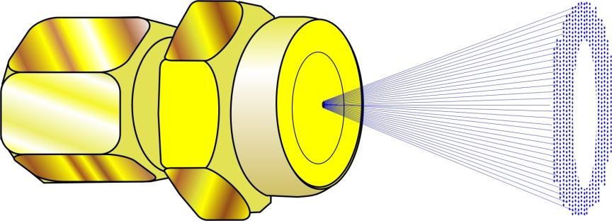
Spray Nozzles
Hollow Cone
Conical shape, outer ring of circular spray
Most widely used
Small to medium droplets of water
Larger orifice/less likely to clog
Effective for dust mixing (knockdown) and redirecting
Usually provided from manufacturer

Slide 5
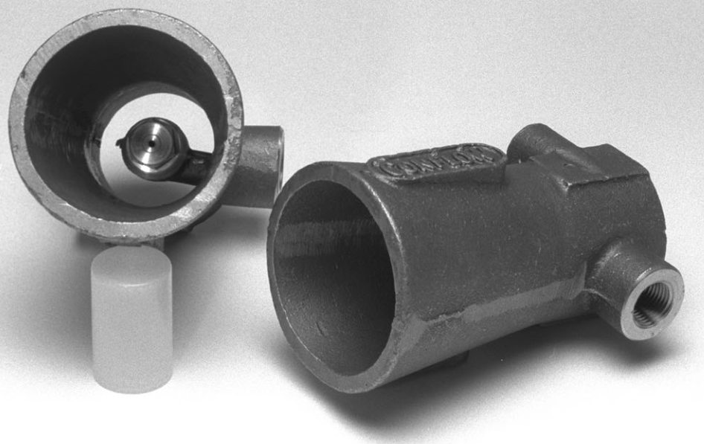
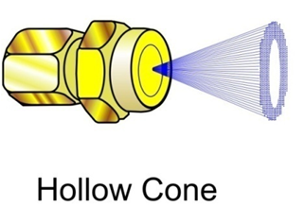
Venturi – Uses Hollow Cone for Redirection
Redirection – direct dust away from workers
very good air movement
Conflow, Inc.
Venturi

Slide 6
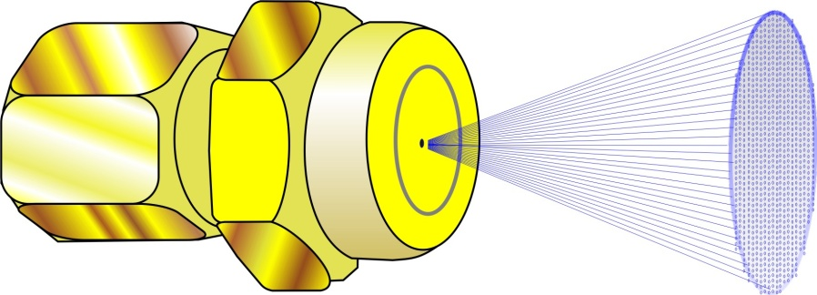
Spray Nozzles
Full Cone
Conical shape with solid circular pattern
Medium to large droplets of water
Provide uniform wetting
Wide range of pressure and flows
Effective for scrubber filters and belt transfer points

Slide 7
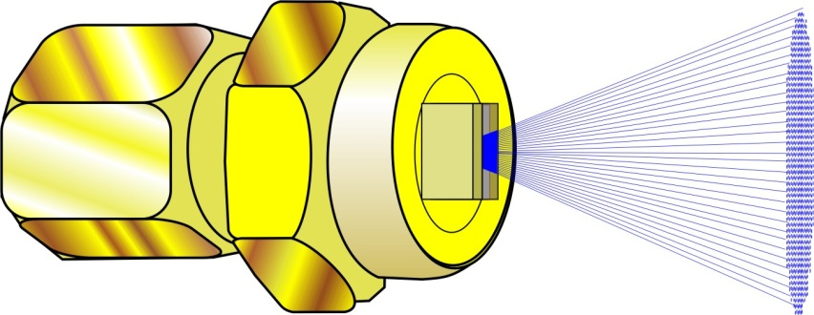
Spray Nozzles
Flat Fan
Produce narrow ‘wall’ of spray at various angles
Wide range of flow and spray angles
Horizontal, high flow and low pressure as boom sprays suppress dust
Vertically mounted on either side of miner directed toward face contains dust for scrubber capture

Slide 8
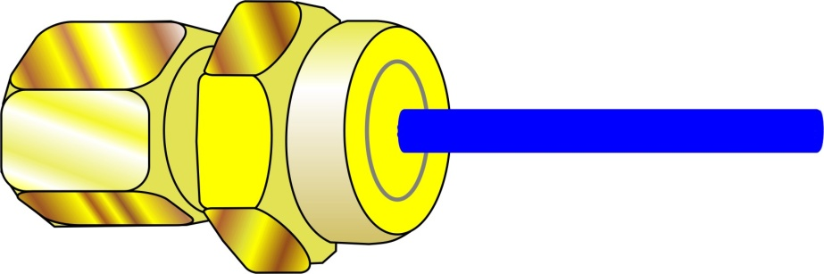
Spray Nozzles
Solid Stream
Straight solid stream of water at high volume
To be used close to the source
Provide uniformity of wetting
Effective for dust suppression bit cooling
Most Commonly used on Shearer Picks

Slide 9
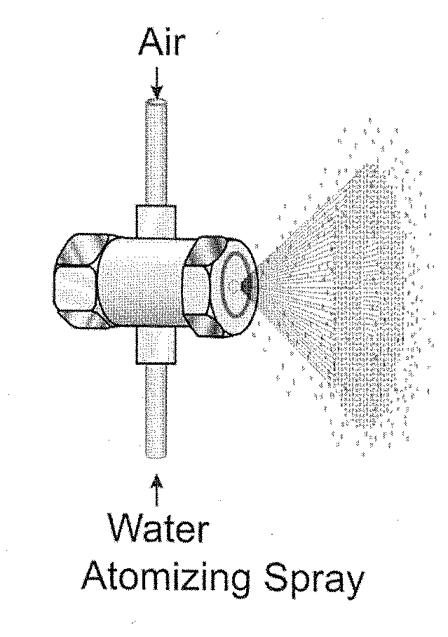
Atomizing Spray
Generally not presently used in coal mining
Uses air pressure, higher water pressures and small orifice to create small droplet size to remove (capture) airborne respirable dust
Easily clogs due to small orifice
  Clean water supply
Very effective at removing respirable dust since droplet size is similar to dust particle size

Slide 10
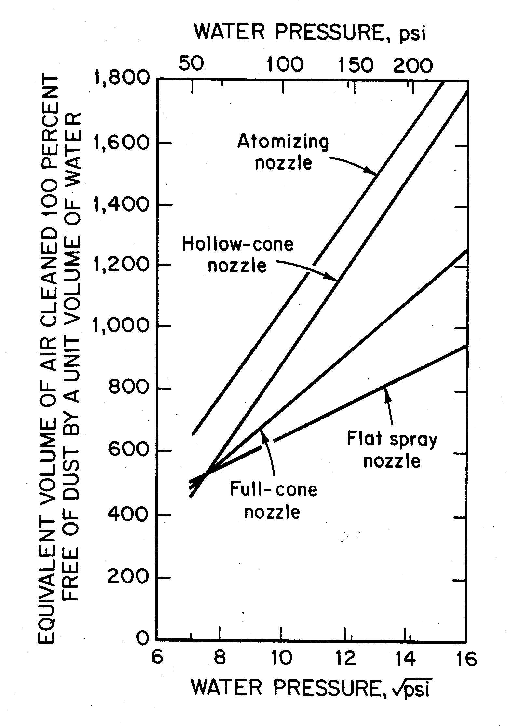
Spray Capture Effectiveness on Airborne Dust
Improved Capture with higher pressures
  Smaller Droplet Sizes
  High Velocity Droplets
Unit gallon of water is more efficient at higher pressures and smaller droplet sizes

Slide 11
Airborne Dust Capture

Slide 12
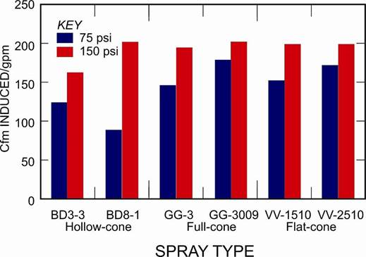
Air Moving Effectiveness

